Slide 1

Controlling Volume with Hand Gestures Using a Webcam

Slide 2





Controlling Volume with Hand Gestures Using a Webcam
A Computer Vision-Based Touch-Free Audio Control System
Student Name: Pavan Kumar Pamu
Mentor Name: Mr. Ram Prasad
Organization: Infosys Springboard
Core Technologies
Python
OpenCV
MediaPipe
PyAutoGUI

Slide 3

Project Statement: The Need for Touch-Free Interaction
Core Aim
To develop a robust computer vision-based application capable of controlling the operating system's volume via specific, predefined hand gestures captured by a standard webcam.
Mechanism
The system utilizes MediaPipe to accurately detect and track 21 hand landmarks in real-time.
Volume control is mapped by calculating the dynamic distance between the thumb and index fingertips.
This distance is directly translated into a system volume level.
Key Applications
Smart Home Environments
Assistive Technology Systems
Advanced Human–Computer Interaction (HCI)

Slide 4
Project Objectives & Expected Outcomes
The successful completion of this project relies on achieving six measurable outcomes, focusing on accuracy, functionality, and user experience.
1
Real-Time Tracking
Accurately process live webcam input to track all necessary hand landmarks without significant latency.
2
Gesture Recognition
Precisely calculate the geometric distance between specific fingertips to recognize and classify volume gestures.
3
Volume Mapping
Map the gesture distance range to the entire system volume spectrum (0–100%) effectively.
4
Smooth Transitions
Implement transition logic to ensure volume adjustments are smooth and incremental, avoiding jarring noise changes.
5
Visual Feedback
Integrate immediate visual confirmation and a volume bar overlay directly onto the live camera feed for user guidance.
6
Hardware Agnosticism
Ensure the application operates robustly using only a standard, inexpensive webcam, requiring no proprietary hardware.

Slide 5





System Architecture: Four Core Modules
Our system is built on a sequential pipeline of four interdependent modules, converting raw visual data into functional system control.
1. Webcam Input & Hand Detection
2. Gesture Recognition & Measurement
Captures live video streams and identifies hand position.
Calculates dynamic distance between thumb and index landmarks.
3. Volume Mapping & Control
4. User Interface & Feedback
Translates distance value into system volume level via OS interaction.
Provides visual overlays and real-time status updates.

Slide 6
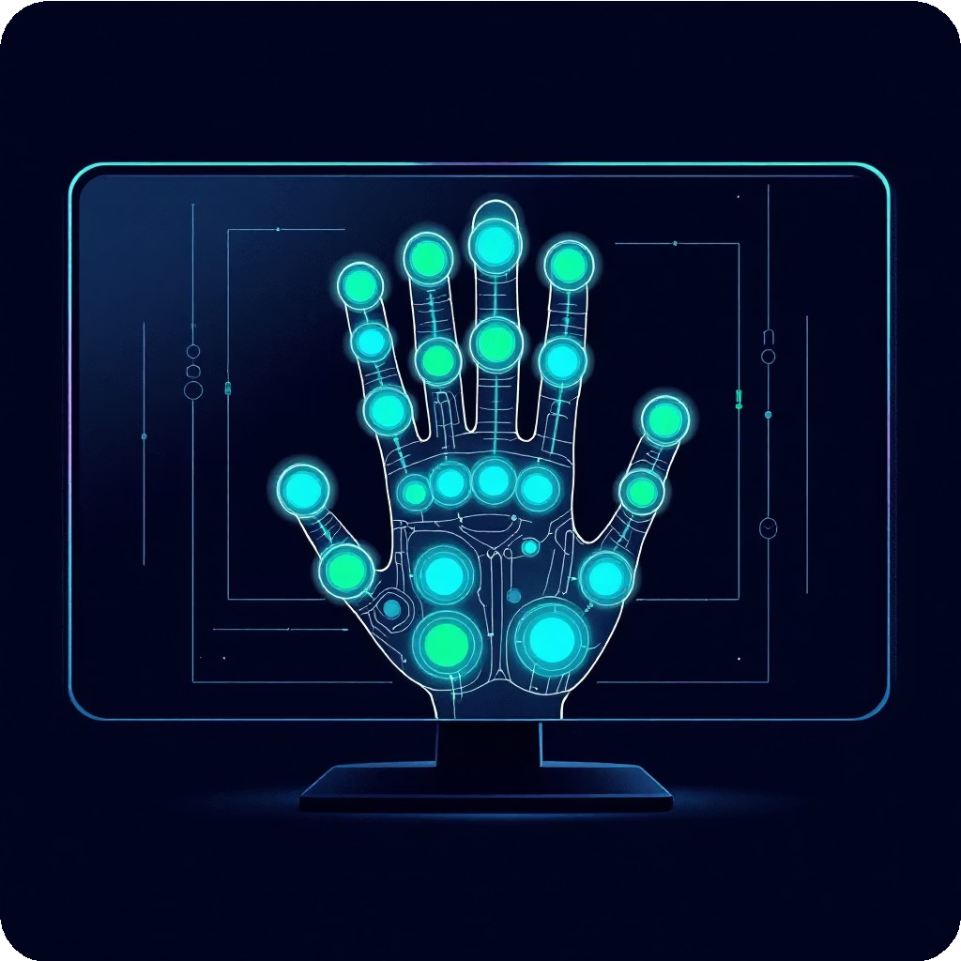
Milestone 1: Webcam Input & Hand Detection (Weeks 1–2)
Implementation Focus
We utilized the OpenCV library for robust, efficient live video capture. MediaPipe's specialized Hand Landmark Model was integrated to identify and track 21 distinct anatomical points on the hand.
Initialize and manage continuous webcam feed.
Apply MediaPipe's processing pipeline for landmark generation.
Expected Output
Stable, low-latency live camera feed display.
Visual overlay of the 21 detected hand landmarks (points and connections) on the hand outline.
Landmark detection forms the foundation for all subsequent gesture analysis.

Slide 7

Milestone 2: Gesture Recognition & Distance Measurement (Weeks 3-4)
Implementation Focus
The core of volume control relies on calculating the Euclidean distance between two key landmark points: the tip of the thumb and the tip of the index finger.
Develop a function to calculate the 3D distance between landmark coordinates.
Establish dynamic thresholds for minimum (Volume 0%) and maximum (Volume 100%) distances.
Verify correct gesture classification based on calculated distance relative to the hand size.
Expected Output
A real-time numeric distance value displayed on the screen, reflecting the gap between the fingertips, along with visual annotation connecting the points.

Slide 8
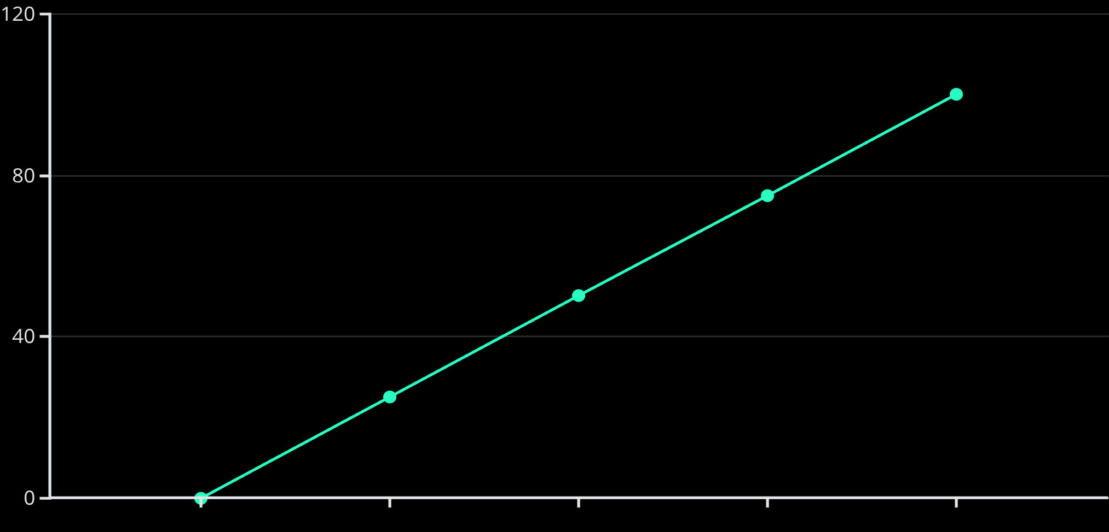
Milestone 3: Volume Mapping & Control (Weeks 5–6)
Implementation Focus
This module integrates the gesture input with system-level control. We use a linear mapping function to scale the measured distance into the 0–100% volume range.
Implement the np.interp function for linear mapping.
Utilize PyAutoGUI (or platform-specific API) to interface with OS audio settings.
Introduce smoothing logic (e.g., exponential moving average) to prevent jittery adjustments.
Expected Output
Accurate, real-time volume adjustments on the operating system matching the user's hand gesture position.
Gesture Distance (Normalized)
Volume Level (%)

Slide 9






Milestone 4: User Interface & Feedback (Weeks 7–8)
The final module ensures the system is intuitive and responsive by providing clear visual feedback to the user.
Volume Indicator
Real-Time Text
System Stability
A dynamic, horizontal bar overlaid on the video feed displays the current volume percentage (0–100%).
Textual output showing the current volume level and recognized gesture (e.g., "Volume: 55%").
Final integration and testing to ensure the application is stable, minimizing crashes and maximizing responsiveness.

Slide 10
Evaluation Criteria: Measuring Success
Project success will be assessed against these four key performance indicators across the development milestones.
Milestone 1
Real-time, low-latency webcam feed integration with accurate, continuous hand detection across various lighting conditions.
Milestone 2
Reliable classification of volume gestures based on correct geometric distance measurement between specified landmarks.
Milestone 3
Smooth and accurate volume control response at the system level, maintaining mapping integrity and avoiding sudden jumps.
Milestone 4
An interactive, stable, and user-friendly interface that provides clear and immediate visual feedback on the control status.

Slide 11
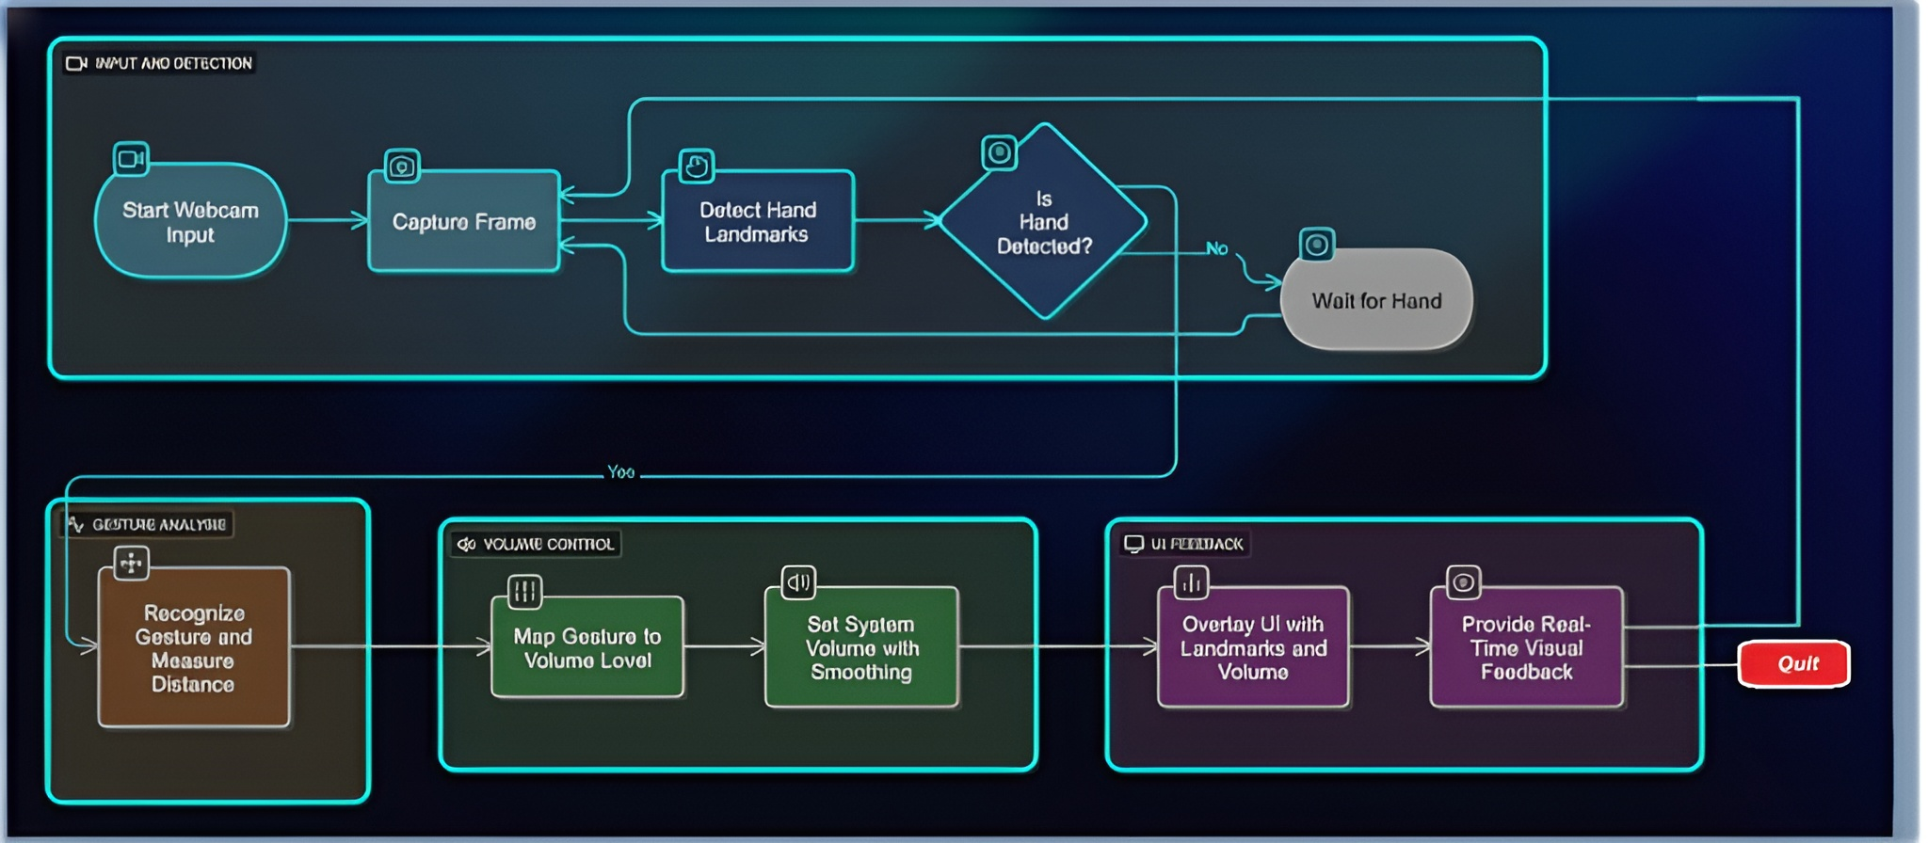
System Workflow Diagram: Data Flow Pipeline
The process represents a linear pipeline where visual data is transformed into a system command.
This sequential flow ensures that each module correctly processes the data before passing the validated output to the subsequent stage, culminating in the final control output.

Slide 12
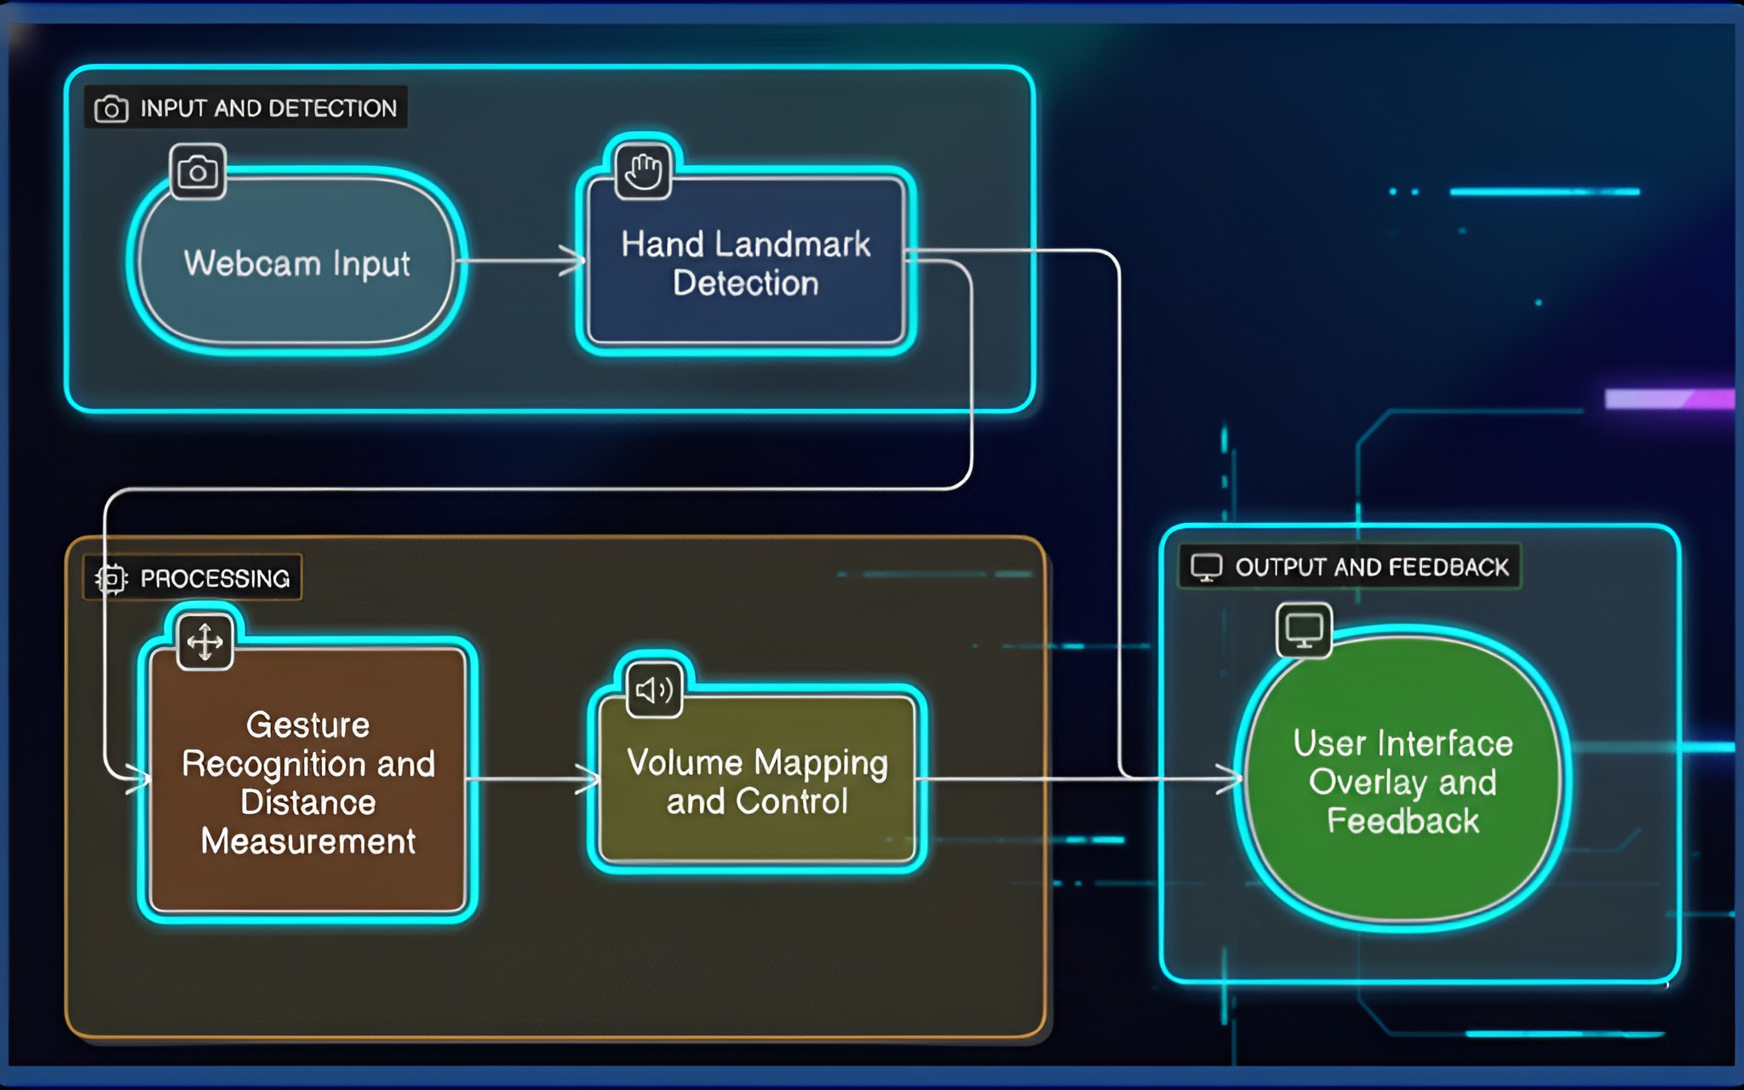
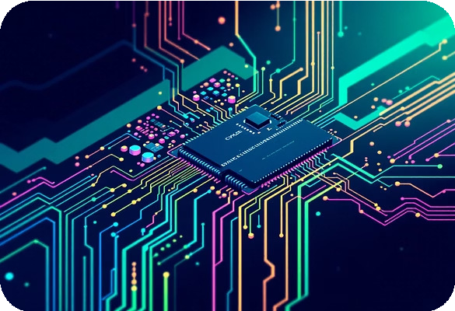
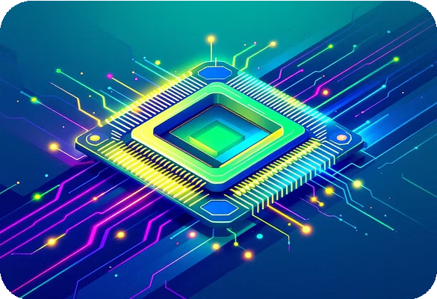
System Architecture Diagram: Layered Components
The layered architecture provides clear separation of concerns, enabling robust development and modular testing of each component. This design choice optimizes for future scalability.

Slide 13


Conclusion and Future Directions
Successful Implementation
We successfully developed and implemented a real-time, gesture-based system for operating system volume control, validating the project's core hypothesis.
Key Achievements
The system demonstrated accurate gesture recognition, responsive volume adjustment, and a stable, hands-free interaction environment.
Impact
The project delivers a working proof-of-concept suitable for accessibility applications and integration into smart home or vehicular control systems.
Future Enhancements
Multi-gesture support (e.g., controlling mute/unmute).
Integration with screen brightness control functionality.
Developing cross-platform compatibility (Windows, macOS, Linux).

Slide 14

Thank You
Questions and Discussion
We appreciate your time and welcome any questions regarding the technical implementation and future scope of the Gesture- Based Volume Control System.
Presented by: Pavan Kumar Pamu

